Slide 1
DEMANDS OF
COLLEGE LIFE AND
STRESS MANAGEMENT
GRIT Program
Presenters: Ruby Martinez, MA, PsyD Student & Nadège Napoleon, MA, PsyD Student

Slide 2
GOALS OF THIS WORKSHOP:
Ice Breaker Activity
Provide an overview of the demands of college life
Define stress and stress responses
Teach practical coping strategies
Cover current research about stress management for college life

Slide 3
EXPECTED OUTCOME OF THIS WORKSHOP:
Ability to learn about expectations/demands of college life
Ability to recognize the stressors of a college student
Learn coping skills for stress management
Learn about available resources and support on campus

Slide 4
ICE BREAKER
Write down the top 3 stressful things you have been either thinking about or experiencing since starting college…

Slide 5
WHAT IS STRESS?
“A state of worry; emotional or
mental tension caused by a
difficult or demanding situation.
Stress is a natural human
response to the difficulties or
challenges in our lives.”
World Health Organization (2023, February 21). Stress. Retrieved September 18, 2023, from https://www.who.int/news-room/questions-and-answers/item/stress

Slide 6
WHAT ARE STRESSORS?
Mental, emotional, physical, or environmental events that trigger stress are called: “Stressors.”
Stressors can be acute (sharp or rapid onset and last a short duration) or chronic (constantly re-occurring and persisting a long time).
Acute stressors are a stressful situation that occur suddenly and results in physiological arousal.
Chronic stressors are actually acute stressors that become long lasting in nature. They increase an individual’s likelihood or risk of developing burnout, anxiety, or depression.
(Lopes Dos Santos, M., Uftring, M., Stahl, CA., Lockie, RG., Alvar, B., Mann, JB., & Dawes, JJ., 2020)

Slide 7
EXAMPLES OF COLLEGE LIFE STRESSORS
Academic Performance Pressure
Social Demands
Financial Challenges
Adjusting To Life Away From Home
(Amanvermez, Y., Rahmadiana, M., Karyotaki, E., de Wit, L., Ebert, D. D., Kessler, R. C., & Cuijpers, P., 2020)

Slide 8
COLLEGE LIFE AND STRESS
College is a time of major transition, demands, and stress.
The case being, students must cope with multiple developmental tasks, such as living away from the family home for the first time and adapting to a changing social environment.
Therefore, stress is a common experience among college students.
Students who have high levels of stress, tend to experience an increased risk of academic difficulties, substance abuse, and emotional problems.
(Arnett, J., 2016)

Slide 9
COLLEGE LIFE AND STRESS
According to recent college student stress statistics, students in the United States are under a lot of pressure.
Challenges, demands, and expectations pile up, threatening to impede academic success.
No matter if it’s chronic, acute, or episodic, stress and the demands of college life can quickly undermine the chances of receiving a diploma and influence other aspects of life.
(Makachoska, M., 2023)

Slide 10
STRESS STATISTICS
87% of students have experienced stress during their college years
64.5% of college students with relationship problems feel stressed because of them
74% of college students are stressed about finances
88% of college students reported their school life to be stressful
89% of students report exams and midterms as their biggest stressor
39.1% of US college students feel well-rested for only one or two days a week
(Makachoska, M., 2023)

Slide 11
WHAT ARE SOME DEMANDS OF COLLEGE LIFE?
Keeping up with assignments, exams, projects and deadlines
Meeting with your advisor routinely to make sure your classes/documents are up to date
Adapting to new learning techniques such as online learning or learning about different technology programs
Income and school loans
Maintaining a social life (joining clubs, making new friends, creating memories)

Slide 12
WHAT ARE SOME DEMANDS OF COLLEGE LIFE?
Public speaking/presentations
Athletic/sports activities
Dorm life vs. Commuter life
Job
Interpersonal relationships and commitments (romantic, friendship, professional)
Having family-related concerns

Slide 13
How too much stress can make you feel…
Irritable, angry, impatient or wound up
Over-burdened or overwhelmed
Anxious, nervous or afraid
Like your thoughts are racing and you can't switch off
Unable to enjoy yourself
Depressed
Uninterested in life
Like you've lost your sense of humour
A sense of dread
Worried or tense
Neglected or lonely
Existing mental health problems getting worse
Signs and symptoms of stress. (n.d.). Mind. https://www.mind.org.uk/information-support/types-of-mental-health-problems/stress/signs-and-symptoms-of-stress/

Slide 14
Physical Side Effects Of Stress
Difficulty breathing
Panic attacks
Sleep problems
Fatigue
Muscle aches and headaches
Chest pains and high blood pressure
Sudden weight gain or weight loss
Developing rashes, acne, or itchy skin
Changes in your body
Existing physical health problems getting worse
Signs and symptoms of stress. (n.d.). Mind. https://www.mind.org.uk/information-support/types-of-mental-health-problems/stress/signs-and-symptoms-of-stress/

Slide 15
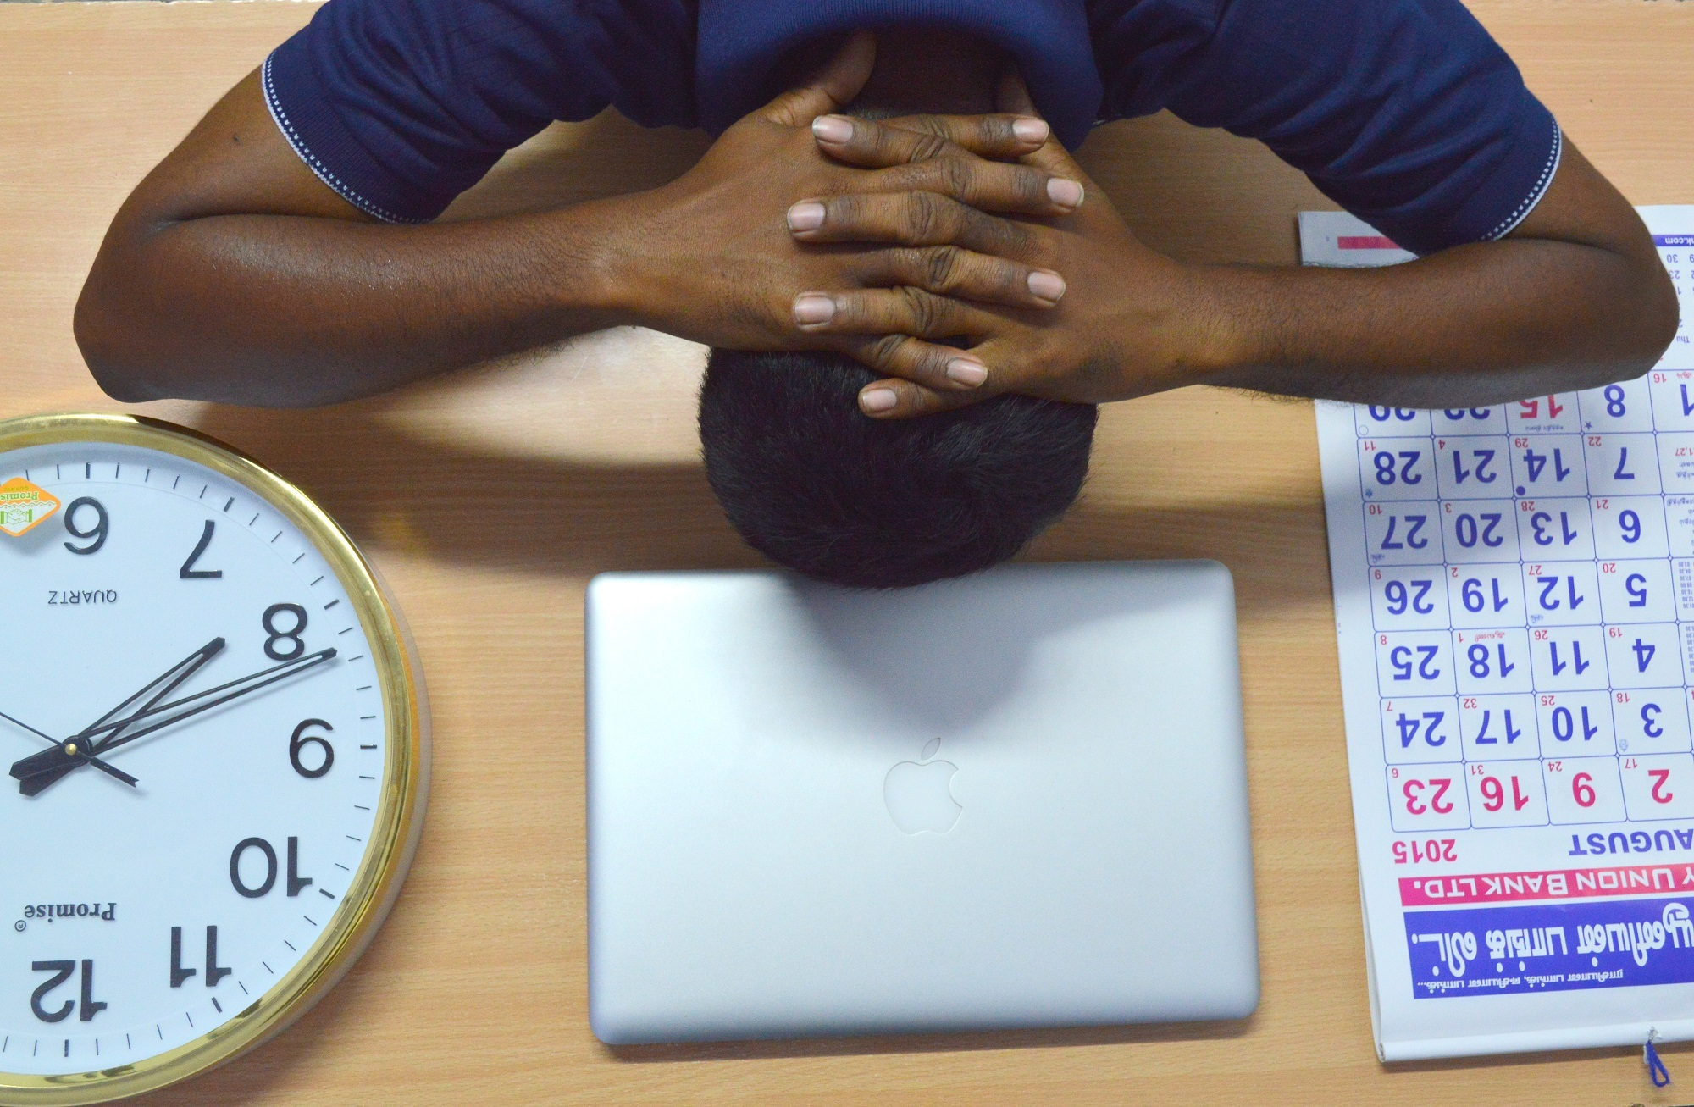
MANAGING YOUR STRESS VIDEO
https://youtu.be/Wh5HyJ1rxzk?si=H9BJ1x6E4Mh3u1KH

Slide 16
COPING STRATEGIES
EXPLAINED
Prioritize Physical Health / Exercise
Explore Campus Activities
Organize Time Based On Energy Level
Take Breaks
Set Manageable Goals

Slide 17
COPING STRATEGIES
EXPLAINED
Go Out With Friends
It’s Okay To Say….”No.”
Develop Interest and Hobbies
Meet New People
Annual Medical Check-Ups

Slide 18
COPING STRATEGIES
EXPLAINED
Create A Safe Place
Healthy Sleep Habits
Eat Regular Meals
Time For Yourself & Relaxation
Get Fresh Air

Slide 19
COPING STRATEGIES
EXPLAINED
Reward Yourself
Positive Self-Talk
Forgive Yourself
Create Support Team
Utilize Mental Health Services

Slide 20
Effective Ways To Manage Stress
Develop Time Management Skills
Manage Peer Pressure
Practice Mindfulness

Slide 21
Time Management Skills
Create an organized schedule (i.e, calendar, notepad, organizer)
Read the syllabus and highlight deadlines
Create a checklist, such as working on a difficult task first
Ask for help, such as tutoring or another classmate
Avoid distractions
Set alarms
Setup a designated work area

Slide 22
Managing Peer Pressure
Pay attention to how you feel and listen to your intuition.
Plan ahead. Planning ahead can help you avoid the stress of assignments due and upcoming events.
Seek advice from others you trust (parent, counselor, mentor).
Sometimes making new friends can be a reason to feel peer pressured. Joining clubs and social events can help ease this pressure.
Fairfax Public Schools (n.d.). How to Handle Peer Pressure. Retrieved September 17, 2023, from https://www.fcps.edu/student-wellness-tips/peer-pressure

Slide 23
Practicing Mindfulness
First, what is mindfulness?
Mindfulness is a set of skills that help us regulate our emotions, practice acceptance, tolerate distress, reduce stress/anxiety, improve our interpersonal relationships, and pay attention on purpose to our experiences.
It is the human ability to be fully present in a moment; aware of where we are and what we are doing.
How can we practice mindfulness? You can practice mindfulness while exercising, breathing, listening, watching, sitting, or walking.
(Welch, A., & Laube , J., MD, 2023)
(2020, July 8). What is Mindfulness? Mindful Healthy Mind, Healthy Life.
Retrieved September 18, 2023, from https://www.mindful.org/what-is-mindfulness/

Slide 24
6 Core Mindfulness Skills
Observing
Observe your thoughts and feelings as they come and go; and noticing the world around you without trying to change it. Helps you to better understand yourself and your reactions to situations.
Describing
Put your observations into words. Use simple and factual language to describe what you see, hear, smell, taste, and feel. Helps you to clarify your thoughts and feelings, and to communicate them more effectively to others.
Participating
Let go of distractions and focusing on the task at hand, whether that be work, hobbies, or relationships. Helps you to be more fully engaged in your life, and to find enjoyment and meaning in your daily activities.
6 Skills to Help You Be Mindful. (n.d.). https://www.psychologytoday.com/us/blog/the-savvy-psychologist/202305/6-skills-to-help-you-be-mindful

Slide 25
6 Core Mindfulness Skills
Non-Judgmental Stance
Cultivate an attitude of acceptance and openness towards yourself and others, and let go of the evaluative judgments that we often make. Helps you to reduce feelings of self-criticism and shame, and develop a more positive and compassionate relationship with yourself.
One-Mindfully
Prioritize your tasks and focus on one moment, task, or thought at a time, giving it your full attention and effort. Helps you be more efficient and effective in your work and personal life, and reduces feelings of stress and anxiety
Effectiveness
Focus on what works in a given situation, rather than what is "right" or "wrong." Helps you to be more adaptive and flexible in your thinking, mindset, and problem-solving, and helps you achieve desired outcomes more effectively.
6 Skills to Help You Be Mindful. (n.d.). https://www.psychologytoday.com/us/blog/the-savvy-psychologist/202305/6-skills-to-help-you-be-mindful

Slide 26
Practicing Mindfulness
EXAMPLE:
Sit in a comfortable position and place your hands on your lap. Focus on breathing through your nose, and exhaling through your mouth. If you get distracted by a noise, acknowledge it, and try to regain focus.
Observe what you see around you in this room, the sounds, etc…
Observe how you are feeling right now: your breath, your muscles, you body against the chair you’re sitting on, the air around you that hits your face, etc.
Now describe your observations without judgment. Put words to them….

Slide 27
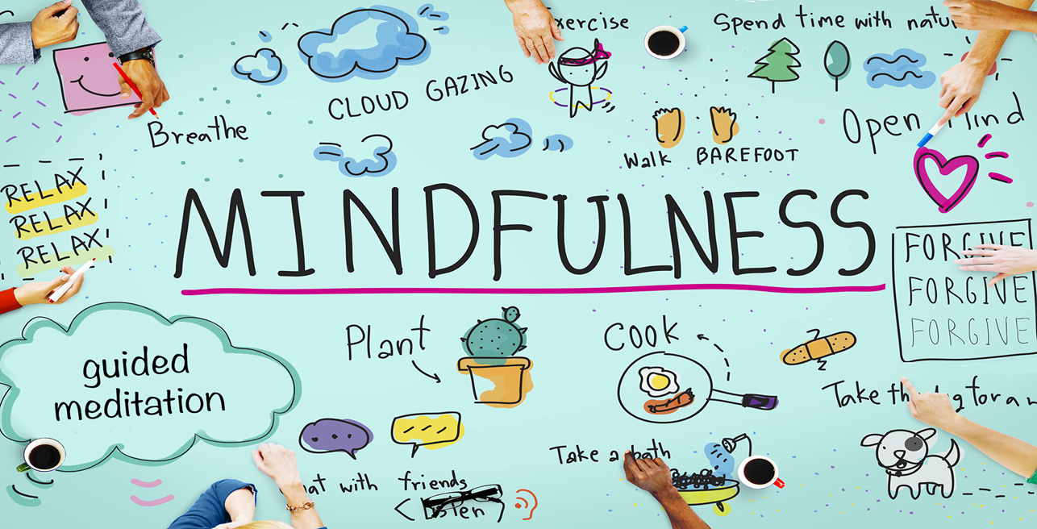
Mindfulness Activity
https://drive.google.com/file/d/18C-x-V2Mm1jR8BgkWuZQCR8z5oeENafd/view?usp=drive_link

Slide 28
Research #1
There has been an increase of depression and anxiety amongst college students since the outbreak of Covid. Practicing mindfulness and using mindfulness applications has been shown to be significantly effective in alleviating these symptoms. A 4-week study conducted at the University of Turku, Fineland that consisted of 561 students and staff as participants. The study was done to determine if using mindfulness app-based interventions can help decrease depression, stress and anxiety. The 561 participants were broken into 2 groups. Group 1 was using a mindfulness application and Group 2 were a part of a control group that were a part of psychoeducational online content.

Slide 29
Results
Mindfulness apps offer a 10-20 min guided meditations that can be daily. Depression, anxiety, and stress were evaluated at the end of the study. Using the mindfulness app for four weeks resulted in small reductions in stress. Participants who used the app more did not experience additional improvement in wellbeing. Mindfulness apps offer benefits to participants in improving mental health. Mindfulness apps are an effective supplement to standard mental health services.

Slide 30
Campus Resources
Uwill
Felician University offers all students free immediate access to tele-therapy through an easy-to-use online platform, as well as direct crisis connection, and wellness programs.
Counseling and Wellness Services
Felician University offers on-campus mental health services to all students via the Counseling Center.
Mental Health Line (1-833-646-1526)
Felician University offers a mental health crisis line, where help and support is made available to all students 24/7/365.
Campus Ministry
Felician University offers students a space to grow and develop spiritually; with a goal to foster a positive and loving community that is inclusive of all peoples, backgrounds, and beliefs, where faith can be put into action.

Slide 31
Campus Resources
Center for Health
Felician University offers a health center to address medical needs located in the lower level of Milton Court, Rutherford Campus. Hours during the Fall and Spring semesters are: Monday through Friday, 8:30 a.m. – 4:30 p.m.
Tutoring Services
Felician University offer students free tutoring from professional tutors and/or peer tutors in our on-campus Tutoring Centers in both Lodi and Rutherford. The Tutoring Centers are DROP-IN ONLY.
The Center for Student Development and Engagement
Felician University offers a variety of intentional co-curricular opportunities for students through events, programs, and workshops that engage and develop students to be productive and responsible citizens. Contact: centerforengagement@felician.edu
Career & Experiential Learning Center
Felician University offers services to educate and prepare students with personal and professional development opportunities, one-on-one career advising, job search strategies, interviewing tips and networking skills. Contact: markowiczm@felician.edu

Slide 32
Contact Info
Dr. Sharon Towler, PhD.
Director of Graduate Educational Leadership
Office: 201-559-6042
E-mail: towlers@Felician.edu

Slide 33
Write down 3 stress management tools you will practice during your school year…
Tool #1
Tool #2
Tool #3

Slide 34

YOUR TURN…
WHAT QUESTIONS WOULD YOU LIKE TO ASK US?

Slide 35
REFERENCES
Amanvermez, Y., Rahmadiana, M., Karyotaki, E., de Wit, L., Ebert, D. D., Kessler, R. C., & Cuijpers, P. (2020). Stress management interventions for college students: A systematic review and meta-analysis. Clinical Psychology: Science and Practice. Advance online publication. https://doi.org/10.1111/cpsp.12342
Chemers, M. M., Hu, L.-t., & Garcia, B. F. (2001). Academic self-efficacy and first year college student performance and adjustment. Journal of Educational Psychology, 93(1), 55–64. https://doi.org/10.1037/0022-0663.93.1.55
Emil Chiauzzi, Julie Brevard, Christina Thurn, Stacey Decembrele & Sarah Lord (2008) MyStudentBody–Stress: An Online Stress Management Intervention for College Students, Journal of Health Communication, 13:6, 555-572, https://doi.org/10.1080/10810730802281668
Fairfax Public Schools (n.d.). How to Handle Peer Pressure. Retrieved September 17, 2023, from https://www.fcps.edu/student-wellness-tips/peer-pressure
Indeed (2023, August 31). 18 Tips for Handling and Avoiding Deadline Stress at Work. https://www.indeed.com/career-advice/career-development/deadline-stress
Lahtinen, O., Aaltonen, J., Kaakinen, J. K., Franklin, L., & Hyönä, J. (2021, May 1). The effects of app-based mindfulness practice on the well-being of university students and staff. Current Psychology; Springer Science+Business Media. https://doi.org/10.1007/s12144-021-01762-z
Lopes Dos Santos M, Uftring M, Stahl CA, Lockie RG, Alvar B, Mann JB, Dawes JJ. Stress in Academic and Athletic Performance in Collegiate Athletes: A Narrative Review of Sources and Monitoring Strategies. Front Sports Act Living. 2020 May 8; 2:42. doi: 10.3389/fspor.2020.00042. PMID: 33345034; PMCID: PMC7739829
Makachoska, M. (2023). 21 Eye-Opening College Student Stress Statistics. What to Become. https://whattobecome.com/blog/college-student-stress-statistics/
Shankland, R., Genolini, C., Riou França, L. et al. Student adjustment to higher education: the role of alternative educational pathways in coping with the demands of student life. High Educ 59, 353–366 (2010). https://doi.org/10.1007/s10734-009-9252-7
Signs and symptoms of stress. (n.d.). Mind. https://www.mind.org.uk/information-support/types-of-mental-health-problems/stress/signs-and-symptoms-of-stress/
Watkins, D. C., Hunt, J. B., & Eisenberg, D. (2012). Increased demand for mental health services on college campuses: Perspectives from administrators. Qualitative Social Work, 11(3), 319–337. https://doi.org/10.1177/1473325011401468
Welch, A., & Laube , J., MD (2023, January 17). Meditation 101: A Scientific Guide on How to Meditate for Stress Reduction and More. Retrieved September 17, 2023, from https://www.everydayhealth.com/meditation/
Zhao S, Zhang Y, Yu C, Zhang H, Xie M, Chen P, Lin D. Trajectories of Perceived Stress among Students in Transition to College: Mindset Antecedents and Adjustment Outcomes. J Youth Adolesc. 2023 Sep;52(9):1873-1886. doi: 10.1007/s10964-023-01788-5. Epub 2023 June 9. PMID: 37296270; PMCID: PMC10255944.

